Slide 1
Organisational Communication Flow
Tanisha Rout & Smaranika Nayak

Slide 2
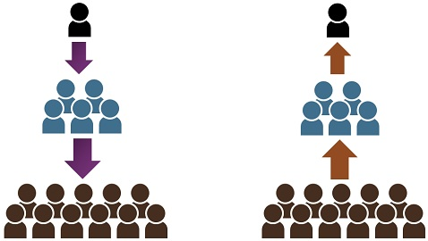
Downward Communication
Upward Communication
Instruction from MD to GM
Senior Manager motivating Juniors
Notice
Order from Supervisor to Worker
Job Instruction
Employee Survey
Suggestion Box
Feedback on Company Policies
Grievance System
Product Quality feedback from
Sales Executive to Management

Slide 3
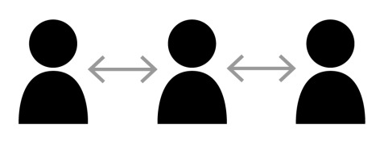
Lateral / Horizontal Communication
Collection follow-up from Finance Manager to Marketing Manager
Recruitment meeting between HR Manager & Sales Manager
Committee meeting
Conferences
Managers Training by HR

